Slide 1
Jan Vermaak
March 2020
Notes:
Af

Slide 2

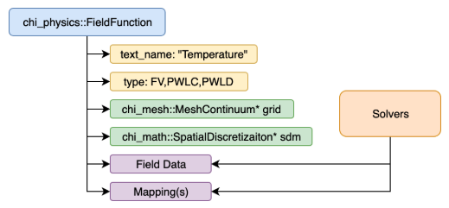
Chi-Tech
Language C++ Logo:
Not part of CERT investigations
July 2018 – Started with a basic grid infrastructure and PWL FE-discretization exploring sweeps
Based around the Field Function concept
SPDS concept design was developed by Adams, Adams, Hawkins, et al.

Slide 3
PDT at the time (November 2018)
Just got outfitted with Modified Interior Penalty (MIP) for diffusion
The ability to arbitrarily cut meshes was available for triangle-extruder, cutting by quarter pin cell for pin-type extruded grids
CERT simulations drew more attention (improvements in experiment process via Tom Conroy)
Grid built on STAPL graph substrate
SPDS was in the queue for features to implement but not essential for CERT-simulations

Slide 4
SPDS design iterations
Fleshed out basic ideas of data flow and defined data objects, i.e. SPDS, SPLS, FLUDS, etc.
SPDS design-iterations were rapidly explored March 2019 – July 2019
Major design benefit: The platform was written in engineering language, for engineers (and engineering students)
Potential for supporting cyclic dependencies was revealed
The Chi-Tech – Linear Boltzman Solver (LBS) was born

Slide 5
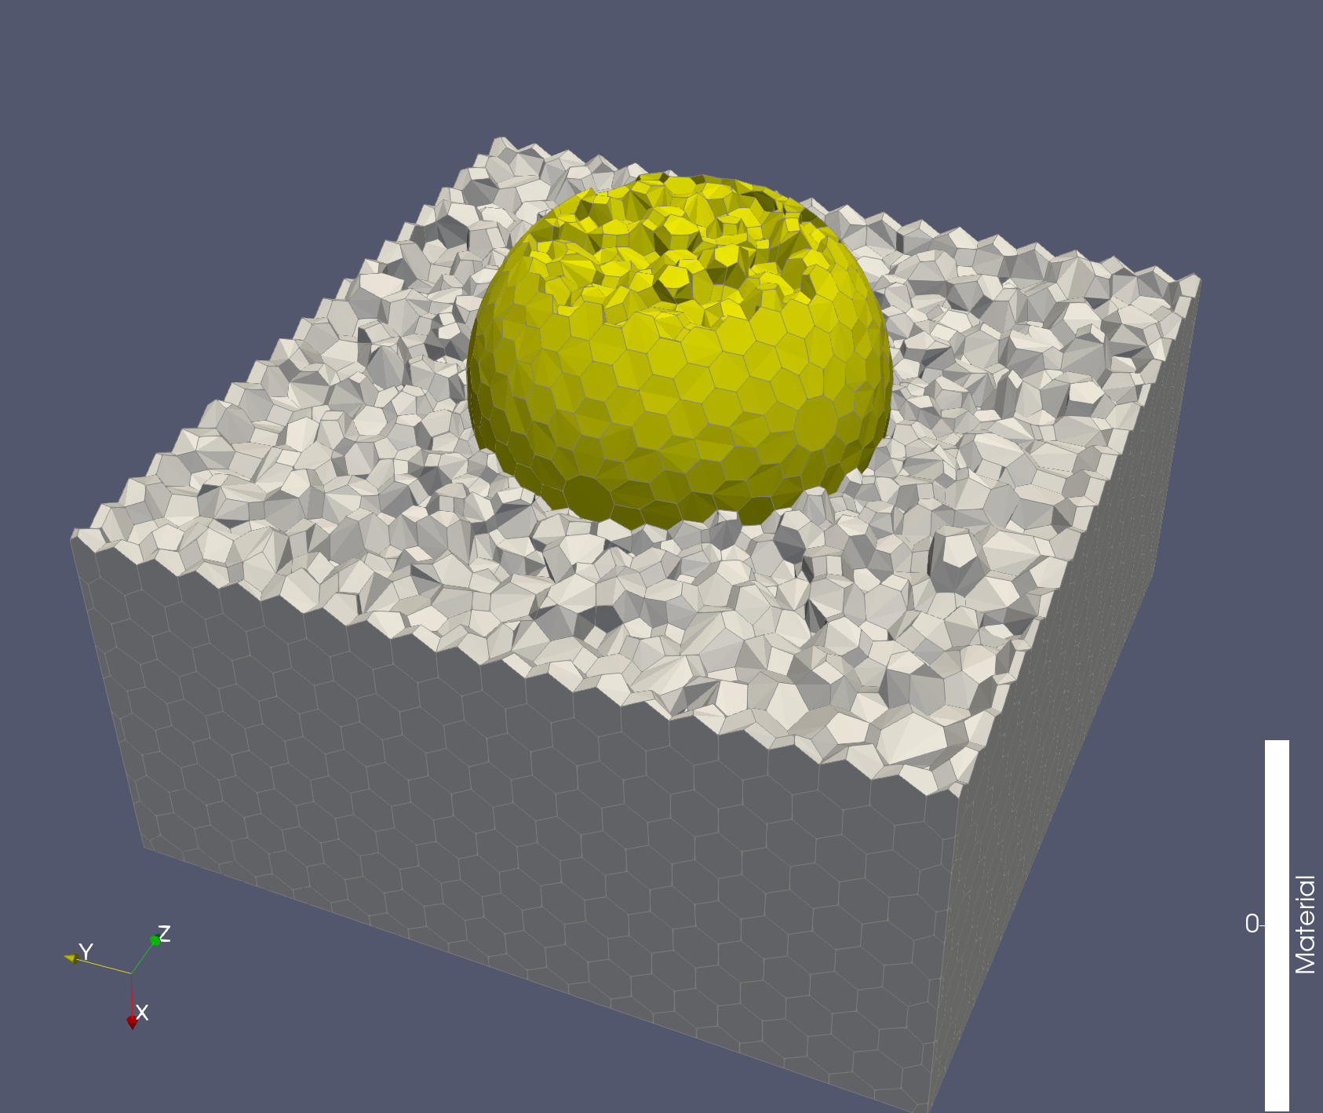
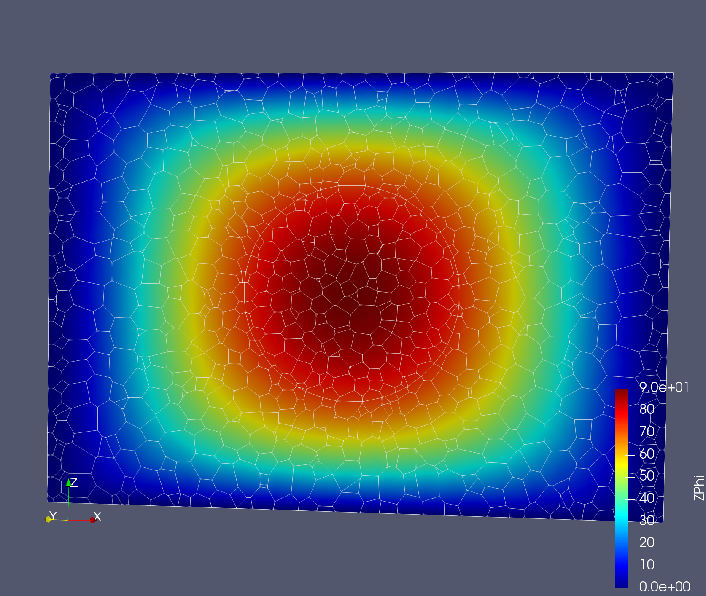
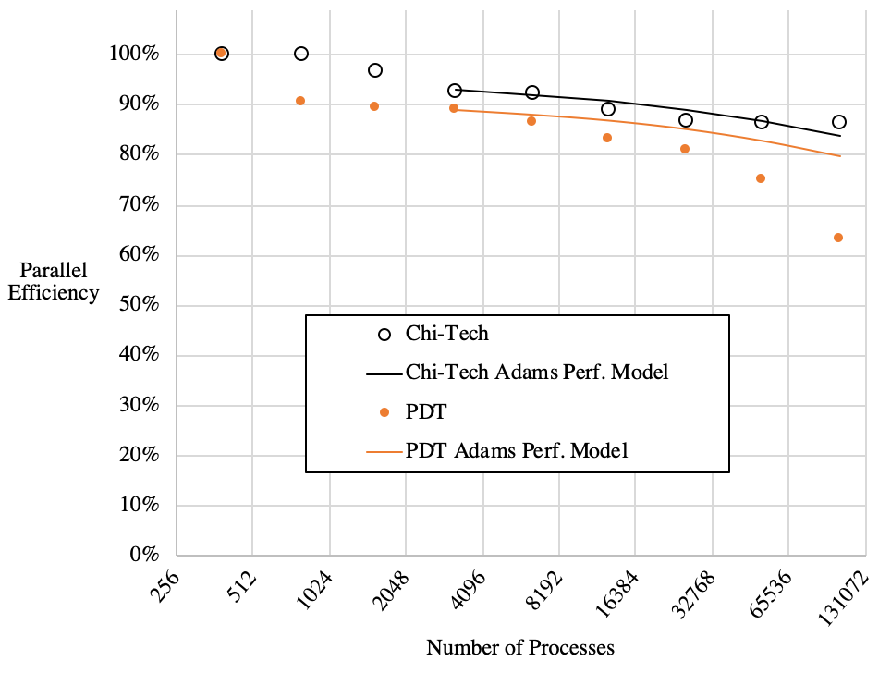
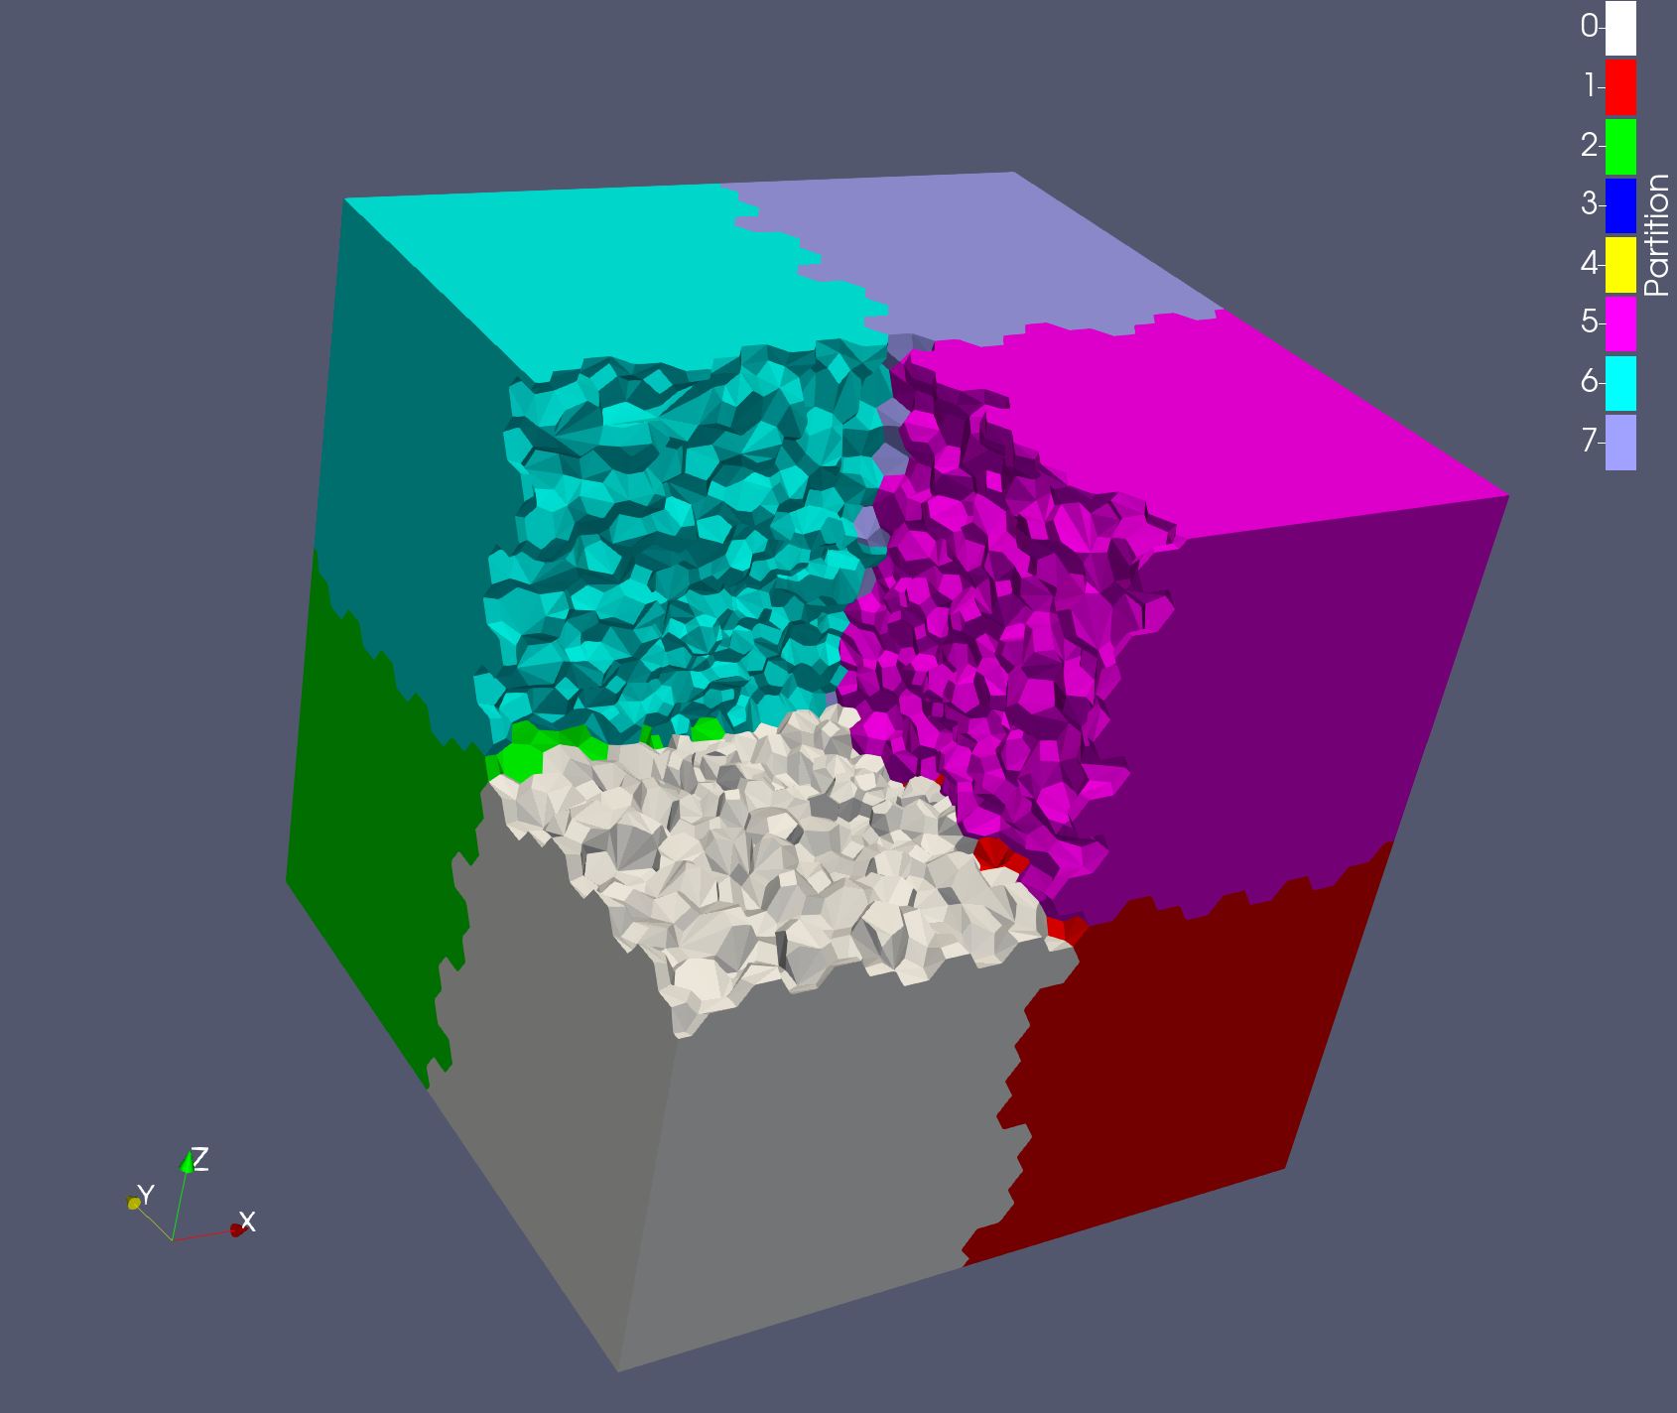
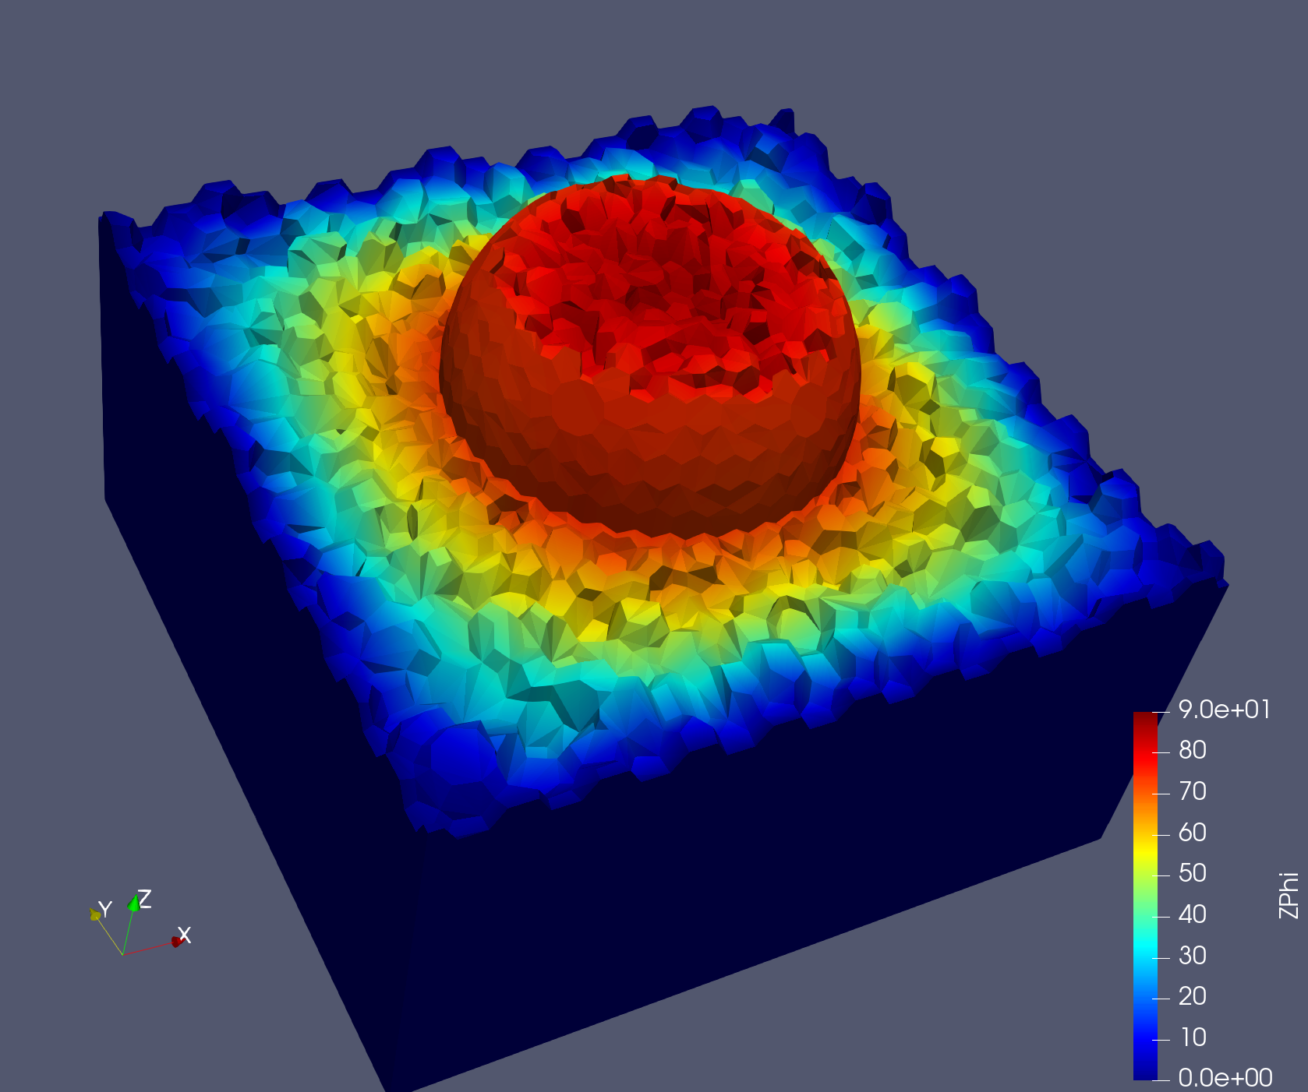
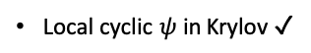

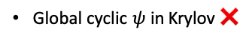
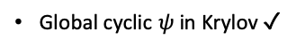
Parallel Transport Sweeps State-of-the-Art
PDT:
Orthogonal Grids
KBA-type partitioning
Speed – 10/10
Parallel efficiency – 8.5/10
Grid Generation
Complex meshing – 6/10
Semi-structured Grids
Source complexity – 5/10
Extensibility– 2/10 …STAPL
Polygons/Polyhedrons – ✓
Modified
Unstructured Grids
Local cyclic dependencies- ❌
Global cyclic dependencies-❌
Unstructured Grids
Curved
Unstructured Grids
Other codes:
Chi-Tech:
Local cyclic dependencies- ✓
Speed – 12/10
Global cyclic dependencies-❌
Parallel efficiency – 9/10 (SAA)
Local cyclic $ψ$ in Krylov ✓
Complex meshing – 8/10
Global cyclic $ψ$ in Krylov ❌
Source complexity – 8/10
Curved meshes - ✓
Extensibility – 9/10
Polygons/Polyhedrons - ✓
Local cyclic dependencies- ✓
Global cyclic dependencies-✓
Local cyclic $ψ$ in Krylov ✓
Global cyclic $ψ$ in Krylov ✓
Curved meshes - ?
ParMETIS-type partitioning

Slide 6
How it works…

Slide 7
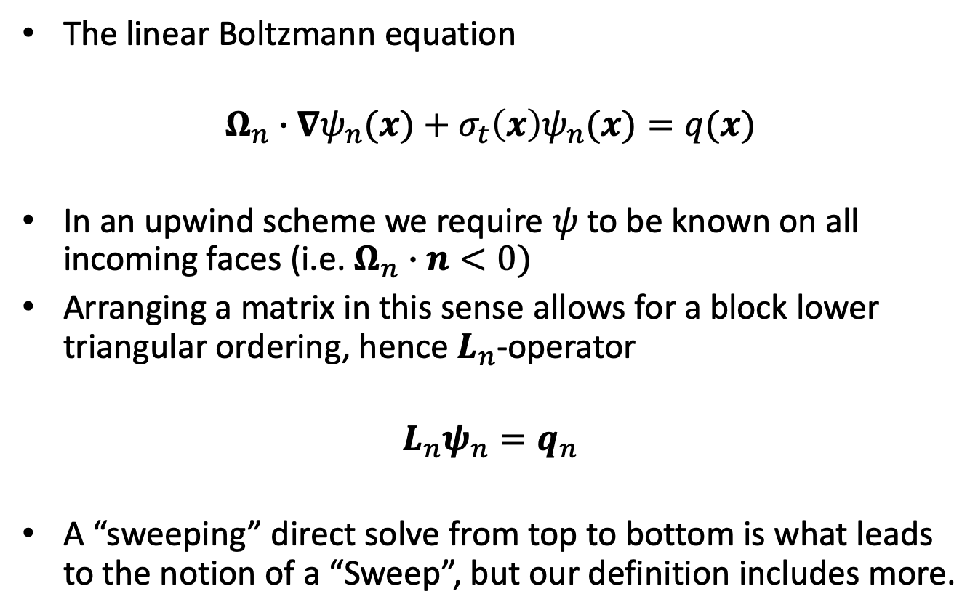
A Sweep
The linear Boltzmann equation
$$Ω_{n}∙∇ψ_{n}(x)+σ_{t}\left(x\right)ψ_{n}(x)=q(x)$$
In an upwind scheme we require $ψ$ to be known on all incoming faces (i.e. $Ω_{n}∙n<0)$
Arranging a matrix in this sense allows for a block lower triangular ordering, hence $L_{n}$-operator
$$L_{n}ψ_{n}=q_{n}$$
A “sweeping” direct solve from top to bottom is what leads to the notion of a “Sweep”, but our definition includes more.
Notes:
Hello

Slide 8
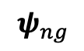
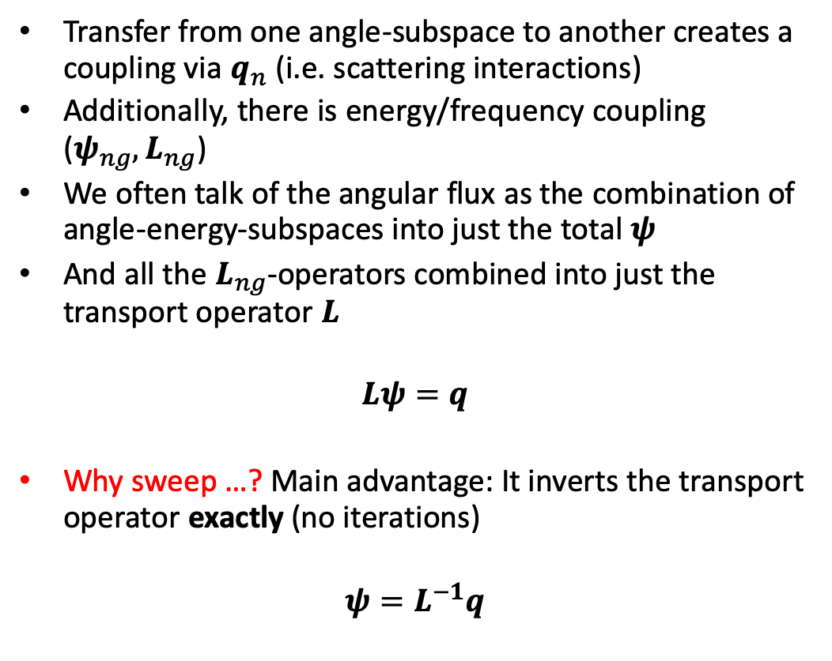
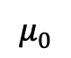
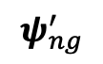
A Sweep continues
Transfer from one angle-subspace to another creates a coupling via $q_{n}$ (i.e. scattering interactions)
Additionally, there is energy/frequency coupling ($ψ_{ng}, L_{ng}$)
We often talk of the angular flux as the combination of angle-energy-subspaces into just the total $ψ$
And all the $L_{ng}$-operators combined into just the transport operator $L$
$$Lψ=q$$
Why sweep …? Main advantage: It inverts the transport operator exactly (no iterations)
$$ψ=L^{−1}q$$
$$ψ_{ng}^{′}$$
$$μ_{0}$$
Target
nucleus
$$ψ_{ng}$$

Slide 9
Some concepts we will cover
Group aggregation:
Group-sets
Group-set subsets
Angle aggregation:
Angle Groups
Angle-sets
CPU caching effects
Sweep Plane Data Structure (SPDS)
Sweep orderings
Sweep Plane Local Sub-grid (SPLS)
Flux Data Structure (FluDS)
Sweep Buffers
Sweep Schedulers

Slide 10
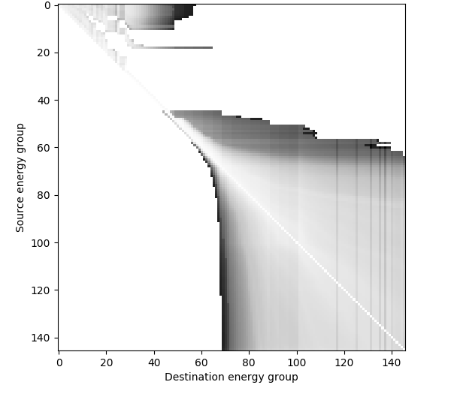
Group aggregation
In some simulations, upper energy groups are dominated by down-scattering
We can save computational effort by lumping groups into groupsets (also saves memory)
Sweep machinery is applied on a groupset-by-groupset basis = custom angular quadratures
Groupset 0 – 4096 angles
Groupset 1 – 4096 angles
Groupset 2 – 2688 angles
Groupset 3 – 1440 angles

Slide 11
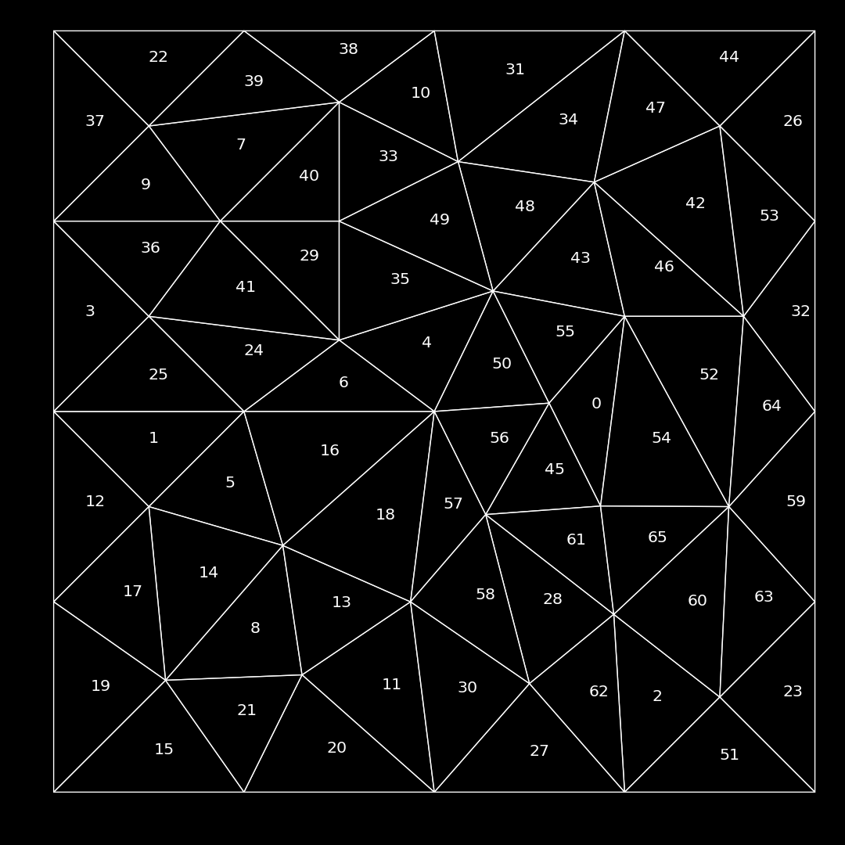
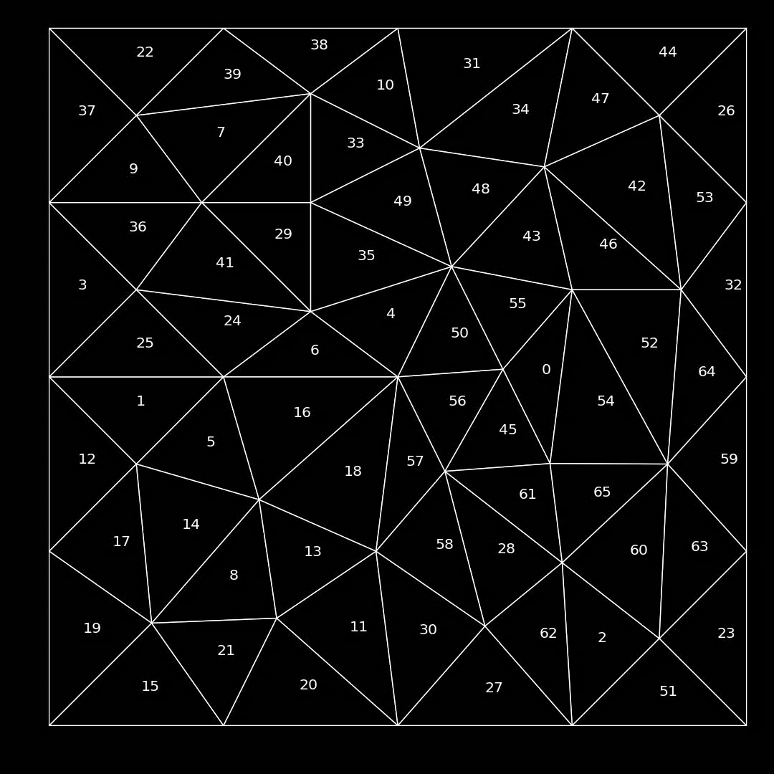
Simple example: Single-group Single-angle

Slide 12
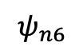
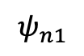
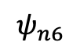
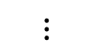
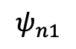
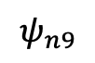
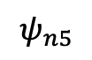
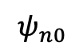
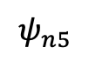
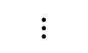
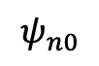
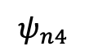
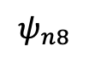
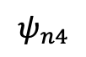
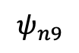
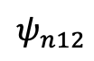
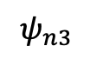
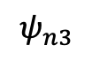
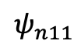
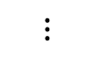
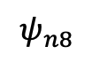
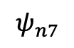
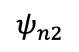
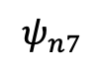
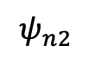
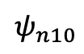
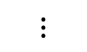
Group-set subset
Group-set 0
$$ψ_{n0}$$
$$ψ_{n5}$$
Group-set 0
Subset 0
$$ψ_{n1}$$
$$ψ_{n6}$$
$$ψ_{n0}$$
$$ψ_{n2}$$
$$ψ_{n7}$$
$$ψ_{n1}$$
$$ψ_{n3}$$
$$ψ_{n8}$$
$$ψ_{n2}$$
Sweep Task n0
$$ψ_{n4}$$
$$ψ_{n9}$$
$$ψ_{n3}$$
$$ψ_{n4}$$
Group-set 1
Group-set 0
Subset 1
$$ψ_{n10}$$
$$⋮$$
$$ψ_{n5}$$
$$ψ_{n11}$$
$$⋮$$
$$ψ_{n6}$$
$$ψ_{n12}$$
$$⋮$$
Sweep Task n1
$$ψ_{n7}$$
$$⋮$$
$$ψ_{n8}$$
$$ψ_{n9}$$

Slide 13
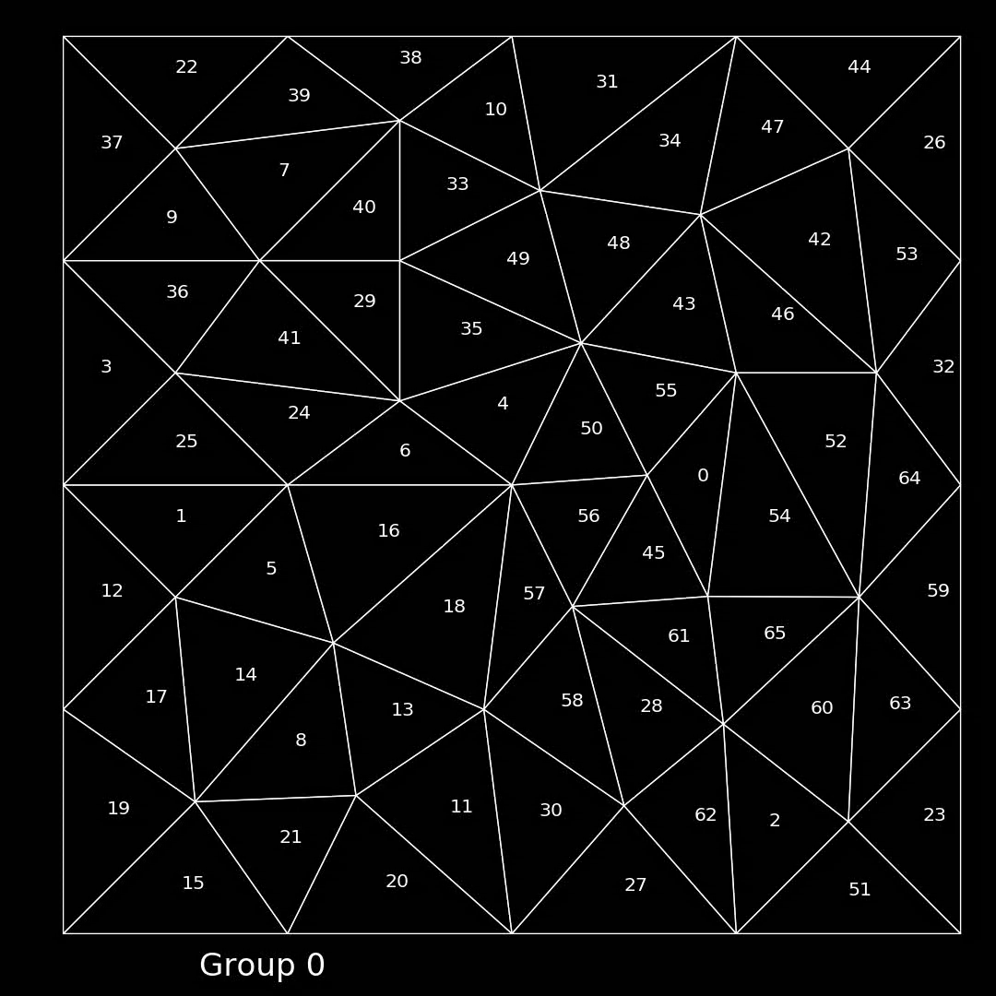
Simple example: Group-set subset Single-angle

Slide 14
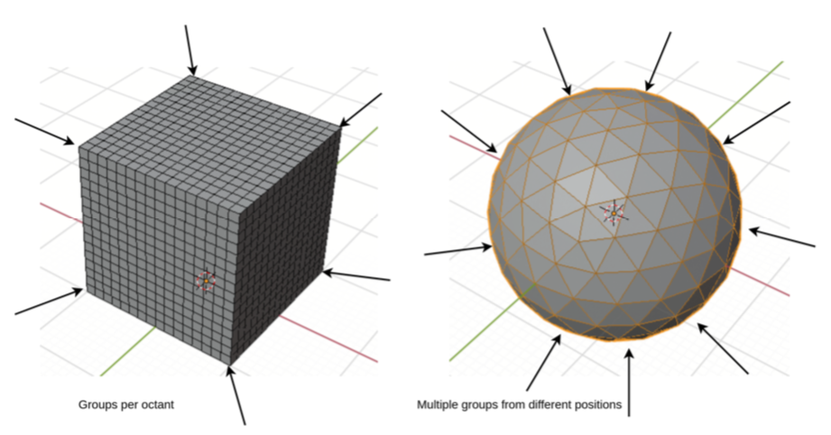
Angle aggregation
First level is “Angle groups”
Angles ordinarily grouped by octant
Greatly improves parallelism

Slide 15
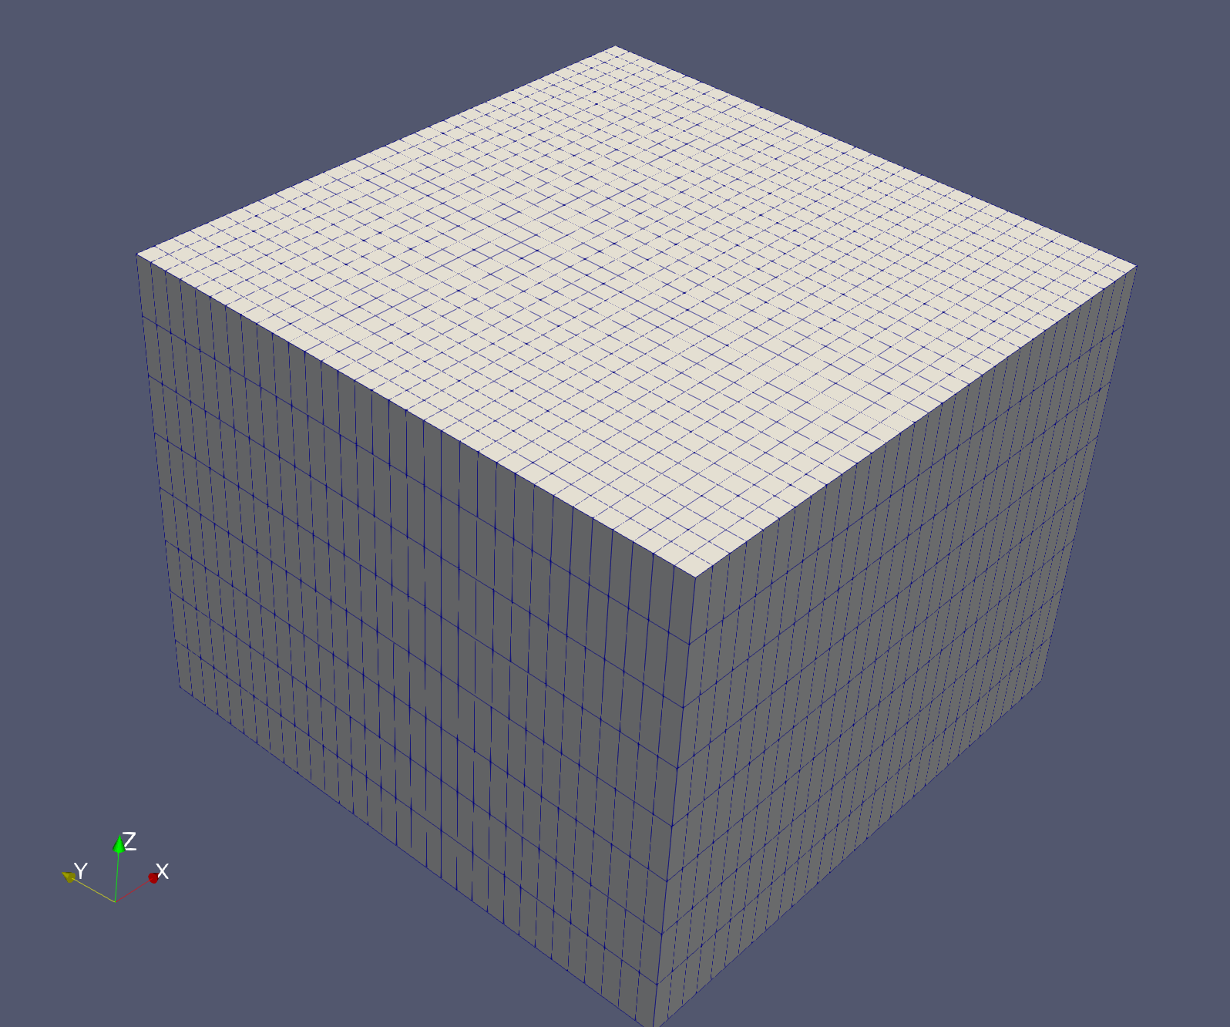
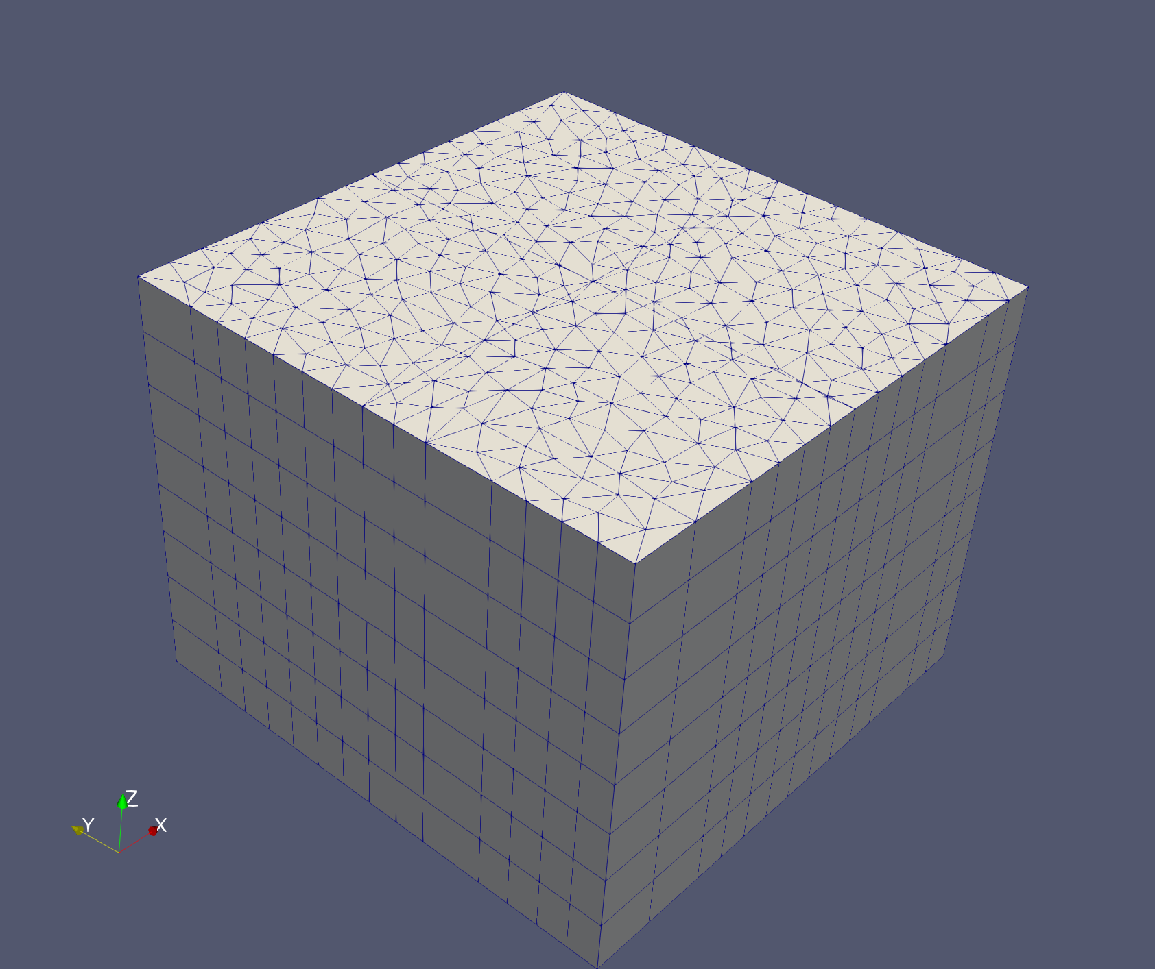
Angle aggregation – cont.
Orthogonal meshes – All angles in an octant have the same sweep ordering (octant-ang. aggr.)
Extruded meshes – given an appropriate angular quadrature: polar angles in a hemisphere sharing the same azimuthal angle have the same sweep ordering (polar-ang. aggr.)
Completely unstructured meshes: out of luck! (single-ang. aggr)

Slide 16
So why is aggregation important?

Slide 17
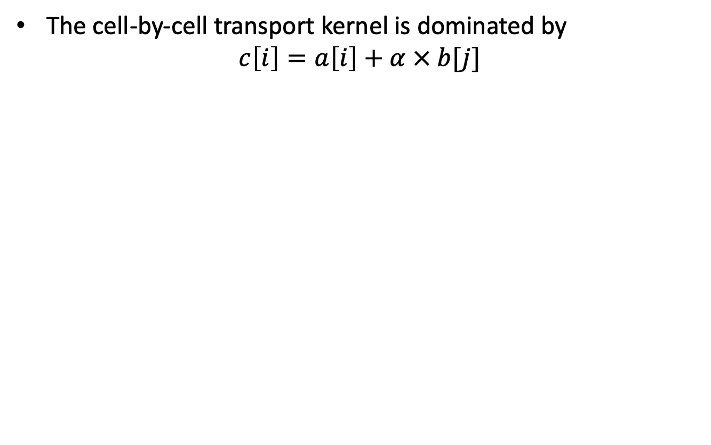
Why do we care about group and angle aggregation? Answer: CPU caching
The cell-by-cell transport kernel is dominated by
$$c\left[i\right]=a\left[i\right]+α × b[j]$$
Socket 0
Socket 1
CPU - Core
CPU - Core
CPU - Core
CPU - Core
L2 & L1 – Cache Memory
L2 & L1 – Cache Memory
L2 & L1 – Cache Memory
L2 & L1 – Cache Memory
L3 – Cache Memory
L3 – Cache Memory
RAM – Main Memory

Slide 18
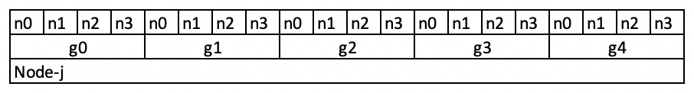


CPU caching 2
The closer data is packed “together”, the better the prefetcher works
Example: Face data
Scales way better with # groups
Example: Flux moments
Scales way better with # groups

Slide 19

CPU caching 3
Sweep kernel has 5 major stages per cell-angle pair
Obtain cell matrices: gradient-, mass-, and surface-gradient
Surface-gradients dot-product with direction vector
Perform surface integrals
Assemble mass-matrix and solve
Store flux moments and outgoing fluxes
Stage A : Angle and group independent
Stage B : Group independent
Stages C,D,E : has group dependent inner portions
Loop over cells
A
Loop over angles
B,C,D,E
Conclusion: Angle and Group Aggregation improves caching performance

Slide 20

Angle-sets
Given aggregated angles and groups the Angle-set is the most basic unit
We have to execute the sweep kernel (sweep chunk) for each angle-set
Performance models are based on the number of angle-sets available for execution. Example[1]:
¹Adams et. al – “Provably optimal parallel transport sweeps on
semi-structured grid”, JCP, January 2020

Slide 21

Sweep Plane Data Structure (SPDS)
These definitions all lead to the collective data structure to execute a sweep in parallel

Slide 22



Computing Sweep Orderings – Stage 1
Partition line
Build a Directed Graph for a given angle (local and global)
Local ordering (location 0):
2
4
Cyclic dependency
Global ordering:
0
1

Slide 23


Computing Sweep Orderings – Stage 2
Find Strongly Connected Components (modified version of Tarjan’s algorithm[2])
Time complexity $𝒪(V+E)$
Remove edges to reduce number of SCC-subgraphs (Not straightforward) and register the removal
Obtain Directed Acyclic Graph (DAG)
²Tarjan R.E., “Depth-first search and linear graph algorithms”,
SIAM Journal on Computing, 1972

Slide 24


Compute Sweep Orderings – Stage 3
Compute a Topographical sorting (Kahn’s algorithm[3]), i.e. 9,10,6,7,1,12,0,11,16,15,8,13,14,3,4,2,5,
Time complexity also $𝒪(V+E)$
Create a Sweep Plane Local Subgrid (SPLS) for perusal by the Angleset’s FLUDS
Build a Sweep Plane Global Ranking to determine global Depth-Of-Graph.
Reminder: We had to remove dependencies in the previous stage. We registered these removals. We still need to handle them
³Kahn A.B., ”Topological sorting of large networks”,
Communications of the ACM, 1976

Slide 25

FLUDS

Slide 26

Flux Data Structure - FLUDS
Sort faces into categories:
Can save ~15% memory
+
Delayed outgoing and incoming bins
+
Outgoing bins for other locations
Beta-phase
Alpha-phase
Communicate to neighboring locations
where their incoming data will be
Traverse the local sub-grid and dynamically push/exchange from “bins” whilst registering deposit/withdrawal locations
Map incoming faces to outgoing faces
Map incoming faces to outgoing faces

Slide 27
Sweep Scheduling and Sweep Buffers
The Depth-Of-Graph sweep scheduling algorithm is very well described in the recent paper by Adams et al. [1]
Superior to First-In-First-Out (FIFO) on KBA-style partitions
Sweep Buffers:
allocate memory for the Sweep Chunks only when necessary,
breaks up communication into packets that fit into the architecture’s buffer size (aka MPI “eager” limit)
dispatches and receives the messages throughout the sweep sequence
The sweep buffers provides status indicators for each angle-set:
Receiving (includes “nothing available yet” and “got what’s available thus far”),
Executing,
Ready to execute

Slide 28
Sweep buffers and reflecting BCs
When non-opposing reflecting BCs are employed they have a slot for receiving data locally
Only when filled by their reflecting angle will they signal the sweep buffer that the angle-set is ready
Blue waits
for Red
This emulates a reflected parallel domain!!
How PDT got to ~1.5 million cores

Slide 29

Delayed Angular Fluxes
The beauty where everything comes together
The angular aggregation objects stores all the angle-sets and their FLUDS and therefore knows how to get the delayed angular unknowns from:
Inter-cell cycles
Inter-partition cycles
Opposing reflecting BCs

Slide 30


A machine of beauty!!

Slide 31
Questions?

